Slide 1
Design our FHS ‘app’ competition
IF YOU CANNOT FIND A GROUP AND WOULD STILL LIKE TO ENTER PLEASE CONTACT YOUR HEAD OF HOUSE!!
Show us what you want in the FHS app!
Submit the entry template with your ideas!
Best entry from each house will qualify to pitch their idea to the panel of judges!
Overall winner will get the possibility of having their app developed & house points!
Deadline for submission of entry template is
Wednesday 29th March!!!
What to do......
1. Get into group of 2 – 4!
2. Download & complete the entry template!
3. Send it to your Head of House!
4. Wait to find out if you have been shortlisted!

Slide 2
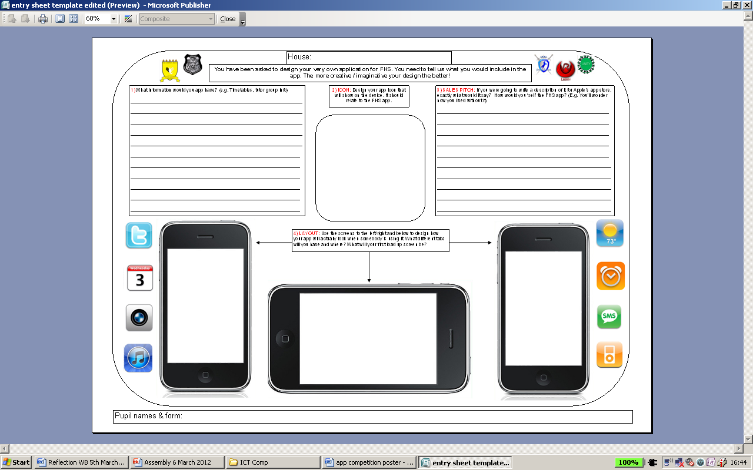
Entry Template
TELL US WHAT YOU WOULD LIKE IN THE APP
DESIGN A SALES PITCH TO GET PEOPLE TO DOWNLOAD THE APP
DESIGN YOUR APP ICON
SHOW US WHAT THE APP WOULD LOOK LIKE

